Slide 1
POWER BI CAPSTONE · DATA / INSIGHTS / STRATEGY
Video Game Sales & Market Performance Analytics
An Interactive Business Intelligence Solution Using Power BI
MohammadHummad Siddiqui · Data Analytics with Gen AI · Imarticus Learning · Power BI Capstone Project

Slide 2
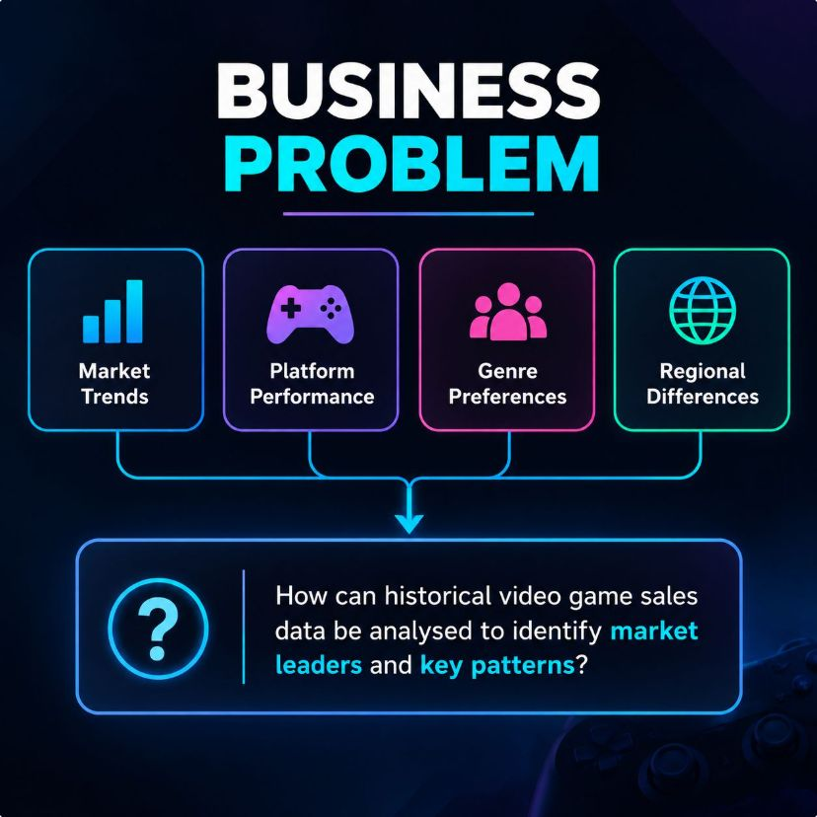
01 · BUSINESS PROBLEM
Historical sales data can reveal where market performance concentrates
Publishers and platform owners need a clear view of historical performance across platforms, genres, publishers, and regions.
Review scores may be associated with commercial sales, but the relationship requires exploration rather than assumption.
Business problem: How can historical video game sales and ratings data be transformed into meaningful insights to identify market leaders, understand regional differences, and explore factors associated with commercial success?
Scope: descriptive and exploratory analysis, not future sales forecasting.
2

Slide 3
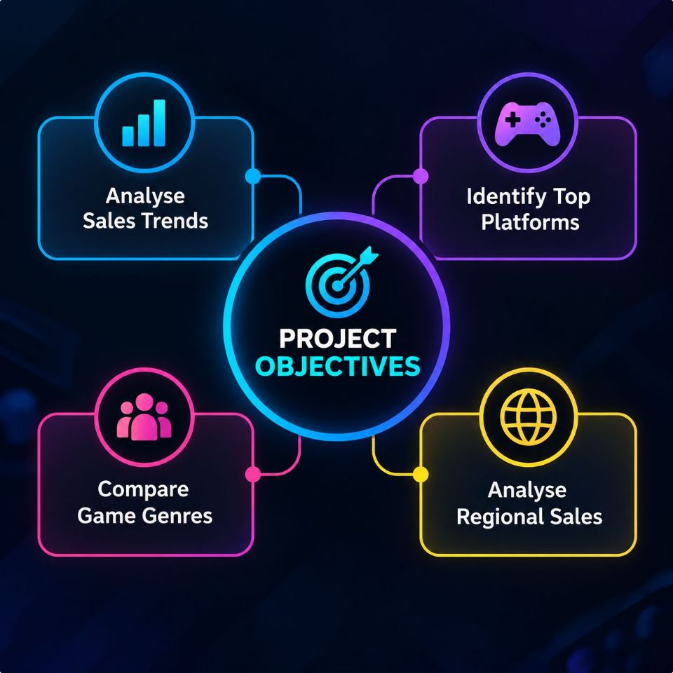
02 · OBJECTIVES
Six objectives connect raw data to decision-ready dashboards
01
02
Analyse total global video game sales and historical trends.
Identify leading platforms based on cumulative global sales.
03
04
Compare sales performance across game genres.
Identify publishers with the highest cumulative global sales.
05
06
Examine regional sales contributions and genre differences.
Explore the relationship between critic scores and global sales in Power BI.
Output: two interactive dashboards designed to support data-driven decision-making.
3

Slide 4
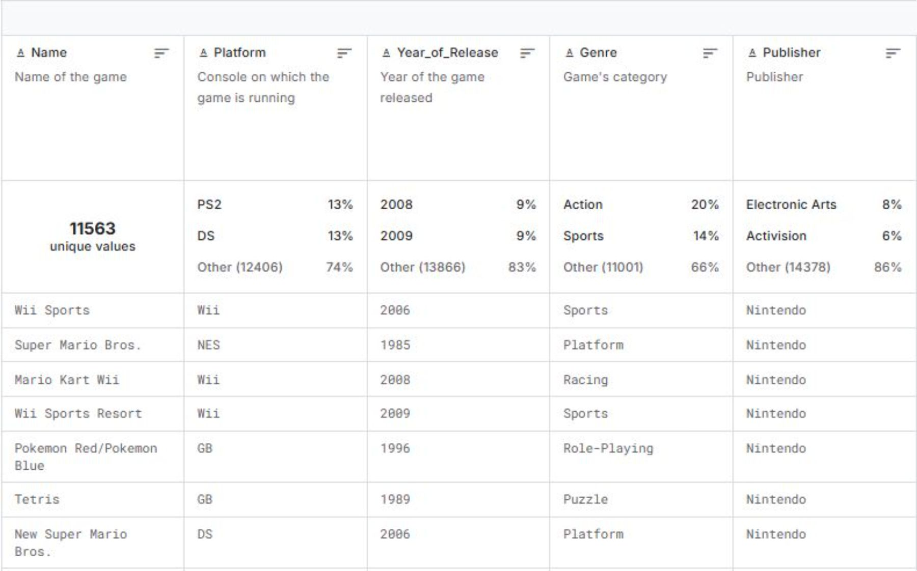
03 · DATASET OVERVIEW
The dataset combines sales, reviews, release timing, and market descriptors
Dataset: Video Game Sales with Ratings · Source: Kaggle.
Categorical fields: Name, Platform, Genre, Publisher, Developer, Rating.
Numerical fields: NA_Sales, EU_Sales, JP_Sales, Other_Sales, Global_Sales, Critic_Score, User_Score.
Time field: Year_of_Release. Sales are measured in millions of units.
Some fields contain missing values; coverage is historical rather than current.
Final cleaned row count: 16,719.
4

Slide 5
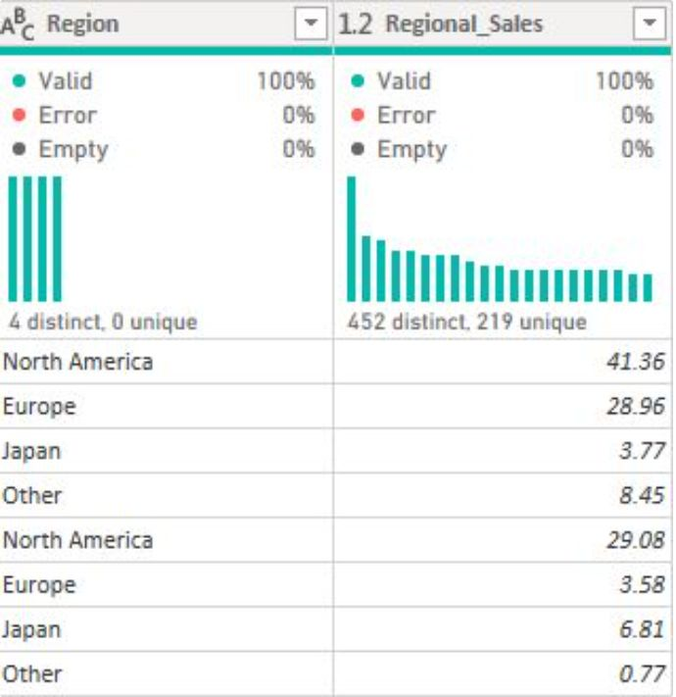
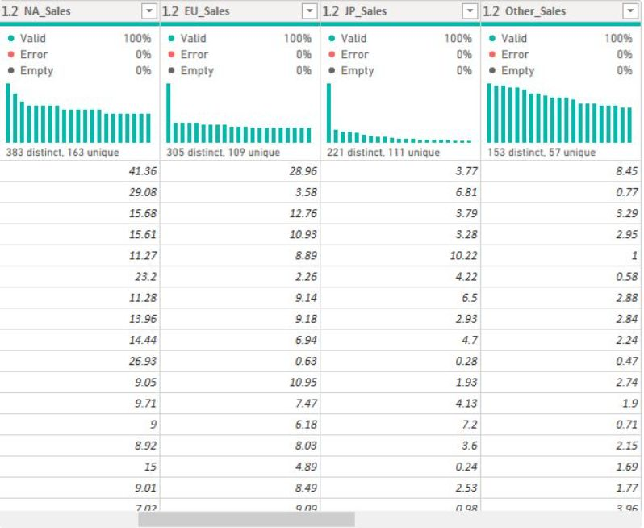
04 · POWER QUERY
Power Query reshaped the data for reliable regional analysis
Long format enables regional comparisons through one Region field and one Regional_Sales measure.
Reviewed data types and corrected invalid release-year values.
Handled missing and unknown categorical values.
Investigated duplicates while preserving legitimate releases across platforms.
Created a unique ReleaseID.
Unpivoted regional sales into Region and Regional_Sales.
Prepared fact and dimension tables for DAX and interactive reporting.
ORIGINAL REGIONAL SALES COLUMNS
TRANSFORMED DATA
5

Slide 6
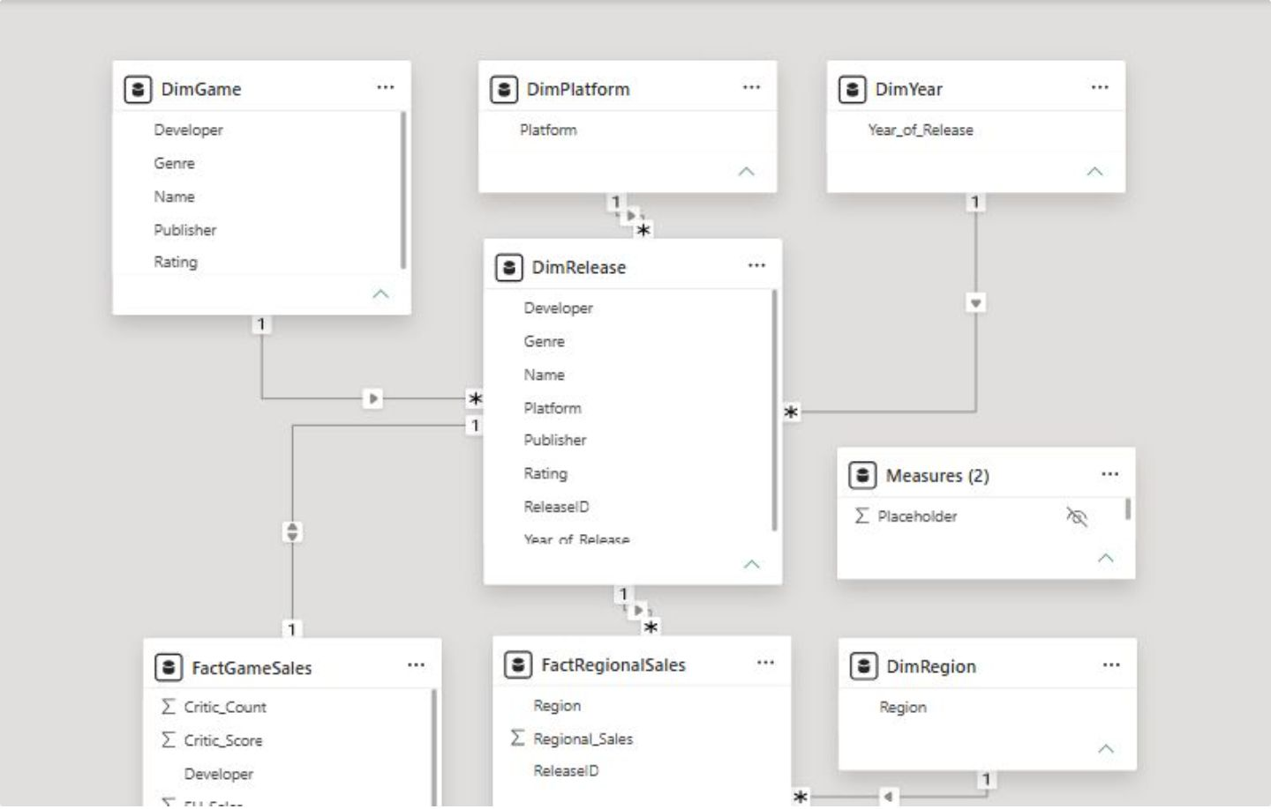
05 · DIMENSIONAL MODEL
Dimensional modelling makes the report filterable and reusable
FactGameSales: global sales and review-related numerical fields.
FactRegionalSales: regional sales organised by release and region.
Dimensions: DimGame, DimRelease, DimPlatform, DimYear, and DimRegion.
Measures table organises DAX calculations.
POWER BI MODEL VIEW
Total Global Sales = SUM(FactGameSales[Global_Sales])
Measures calculate dynamically according to report filters and relationships.
6

Slide 7
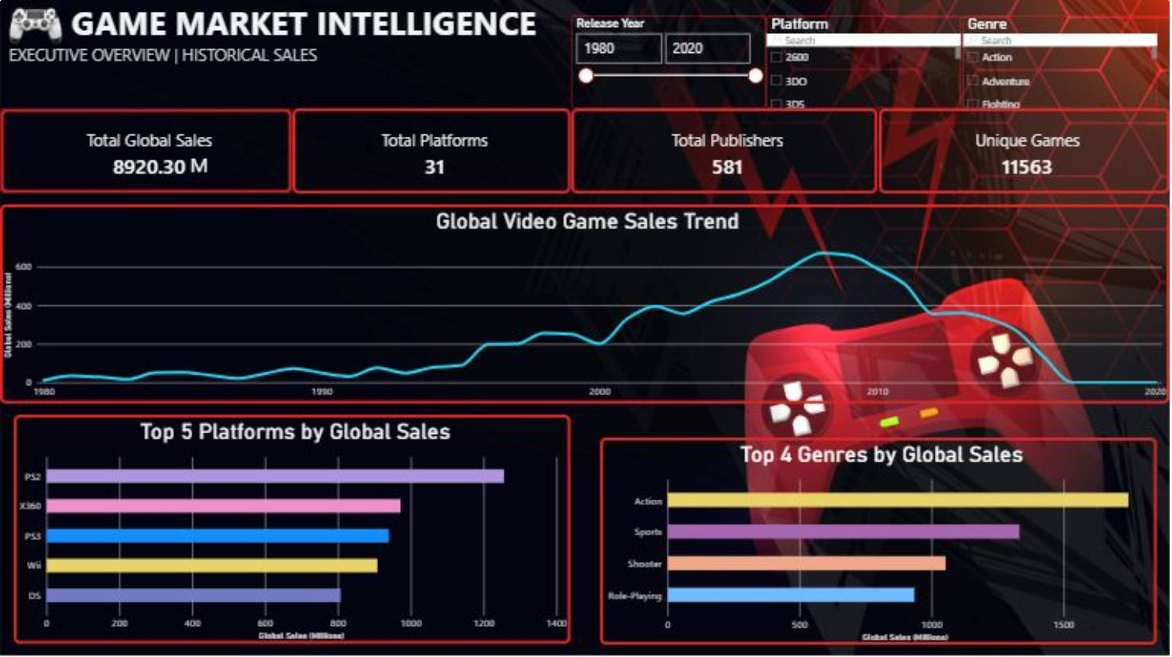
06 · DASHBOARD 01
Executive Overview turns the market into an interactive first read
KPI cards: Total Global Sales, Total Platforms, Total Publishers, and Unique Games. Slicers: release year, platform, and genre.
FULL EXECUTIVE OVERVIEW DASHBOARD
7

Slide 8
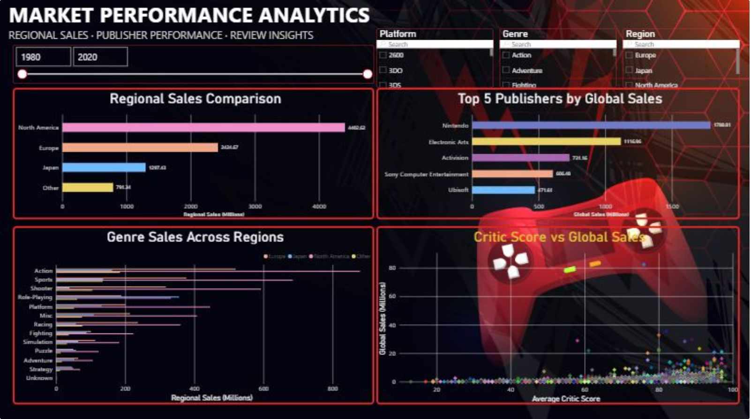
07 · DASHBOARD 02
Sales & Regional Intelligence adds geography, publishers, and review context
Slicers: platform, release year, genre, and region. The scatter chart explores association, not causation.
FULL SALES & REGIONAL INTELLIGENCE DASHBOARD
8

Slide 9
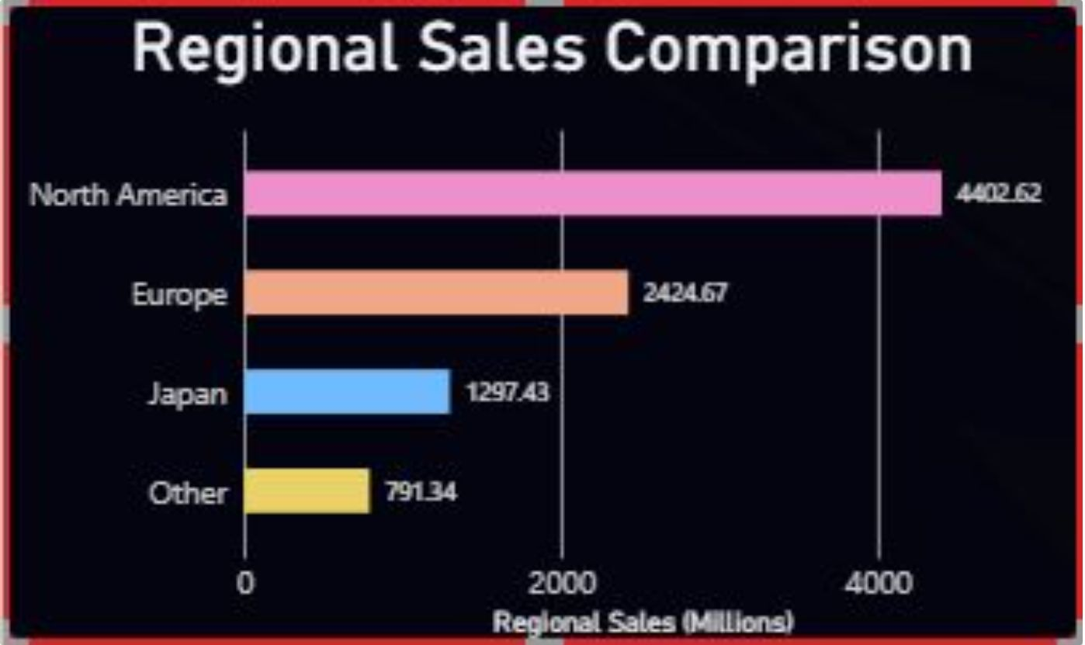
08 · VERIFIED FINDINGS
The dashboard shows a large market, concentrated leaders, and regional differences
Overall: approximately 8,920.30 million units in total global sales.
Platforms: among the five displayed, PS2 ranks first, followed by X360, PS3, Wii, and DS.
Genres: among the four displayed, Action ranks first, followed by Sports, Shooter, and Role-Playing.
Publishers: among the five displayed, Nintendo ranks first, followed by Electronic Arts, Activision, Sony Computer Entertainment, and Ubisoft.
Critic scores: sales vary considerably at similar scores; a small number of high-sales outliers; other factors may matter.
REGIONAL GRAPH
9

Slide 10

09 · RECOMMENDATIONS, LIMITATIONS, AND CONCLUSION
Use the dashboards to frame decisions, not to overstate certainty
Recommendations
Use historical platform rankings as a starting point, not a forecast.
Examine genre performance when evaluating portfolio opportunities.
Account for regional differences in localisation, distribution, and marketing.
Consider critic scores alongside other business information.
Use interactive reports to investigate platforms, genres, years, and regions.
Limitations and conclusion
Missing values, historical coverage, unit sales rather than revenue or profit, and descriptive rather than causal analysis limit interpretation.
Critic-score patterns do not establish whether ratings drive sales; rankings are limited to this dataset and the displayed categories.
Power Query, dimensional modelling, DAX, and two complementary dashboards transform raw data into business insight.
Future scope: newer sales data, reliable financial revenue, and statistical modelling of sales drivers.

